Slide 1
EE207 Solid State Devices
S. Lodha
Carrier Statistics
Supplementary Slides
Acknowledgements:
Advanced Semiconductor Fundamentals, R. Pierret, Purdue University

Slide 2
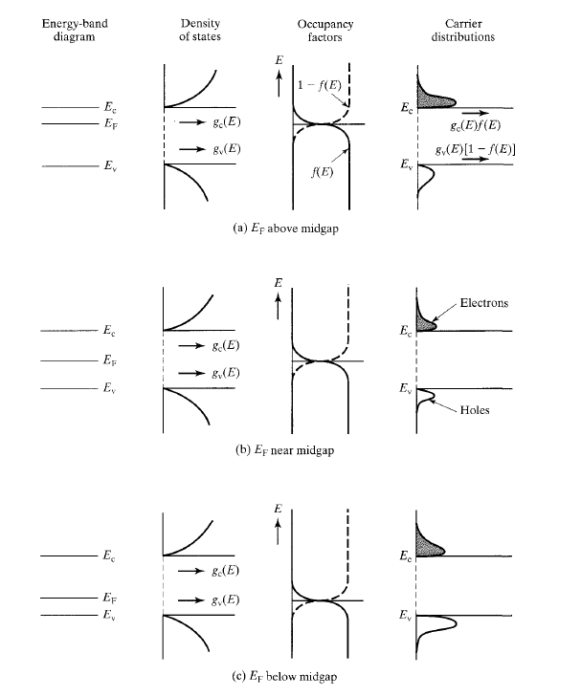
Carrier Distributions

Slide 3
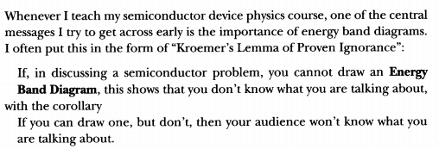
Energy Band Diagrams
Quote from Herbert Kroemer (Nobel Prize in Physics, 2000)

Slide 4
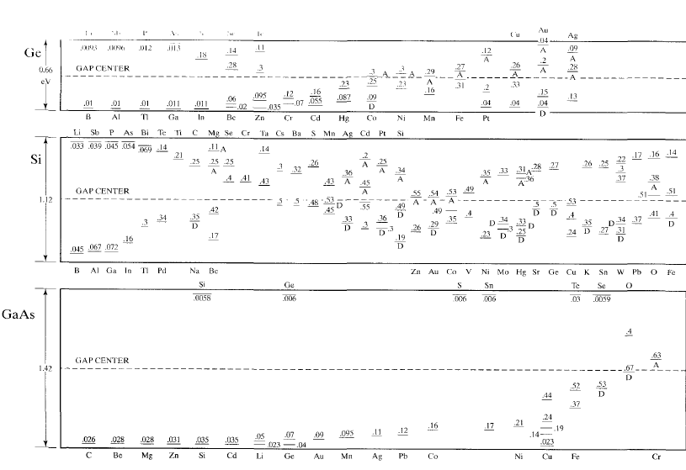
Impurities
Energy levels for various impurities

Slide 5
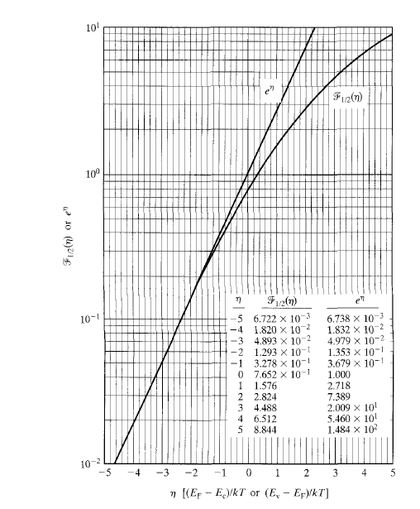
Fermi Dirac Integral

Slide 6
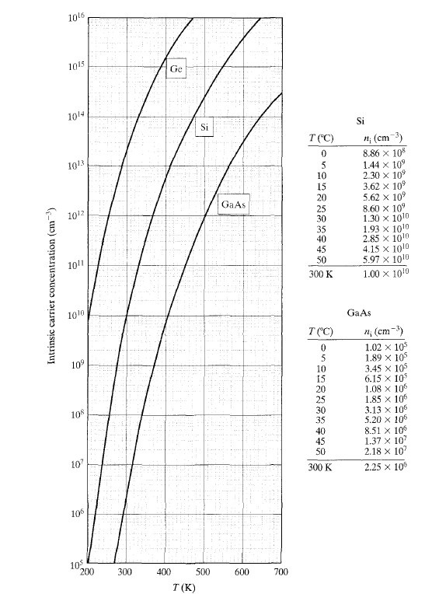
Intrinsic Carrier Conc

Slide 7
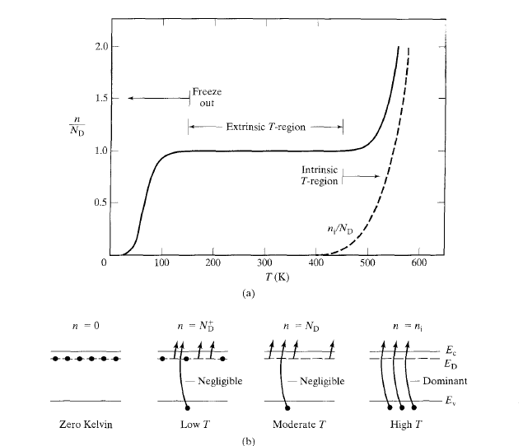
Concentration vs T

Slide 8
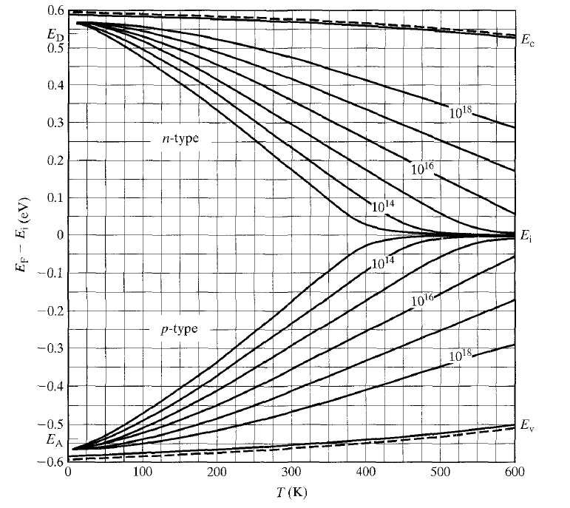
Fermi level position vs doping

Slide 9
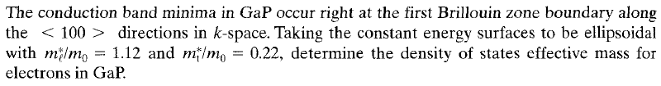
Problem 1

Slide 10
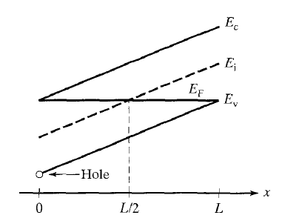
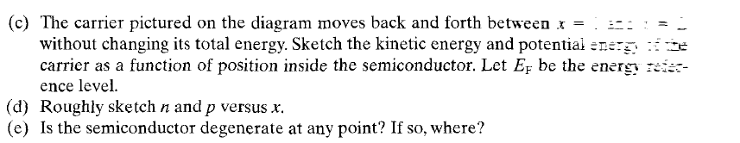
Problem 2

Slide 11
Problem 3
At T=300 K, a p-type semiconductor (N_{A}≠0, N_{D}=0) is doped in such a way that it is at the threshold of becoming degenerate. Find out the position of the Fermi level of this semiconductor at T=450 C. Assume at T=300 K, n_{i} = 10⁸ cm⁻³, E_{G}=1.25 eV, kT =25 meV and equal effective masses for electrons and holes. Also assume that the band gap is independent of temperature

